Slide 1
JULY FINANCIAL/ ENROLLMENT REPORT
Board Meeting July 18, 2024

Slide 2
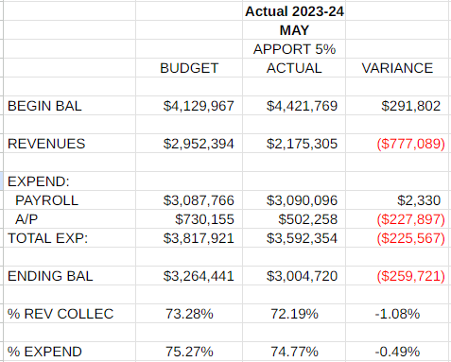
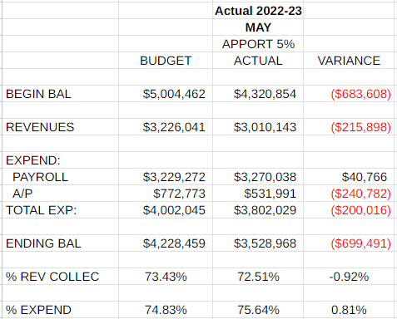
Monthly Revenues, Expenditures and Fund Balance Compared to Projected - May
Revenues for the month are $777,000 less than projected. Due to the tax collections for the year (all in the fall and almost nothing in the spring), we have received 1.08% less revenues than projected, compared with .92% last year. This makes sense as each month we have been ahead in revenues by 3-4% each month. Payroll is very close to projected and this month we spent about $225,000 less than projected in accounts payable. We are still spending less for the year in comparison with last year (.49 less than projected this year and .81% more last year). I will have full revenue, expenditure and fund balance projections with the June and July reports next month.

Slide 3
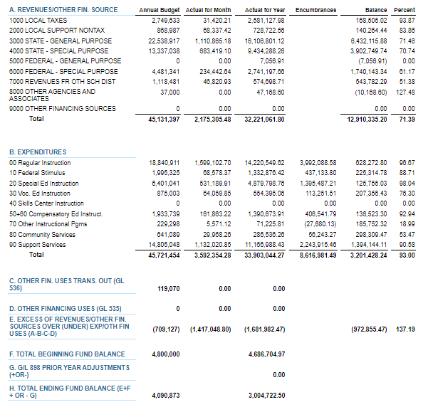
MAY 2024 BUDGET STATUS REPORT – GENERAL FUND

Slide 4
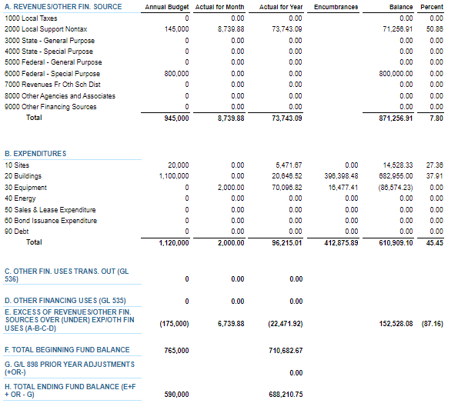
MAY 2024 BUDGET STATUS REPORT – CAPITAL PROJECTS FUND

Slide 5
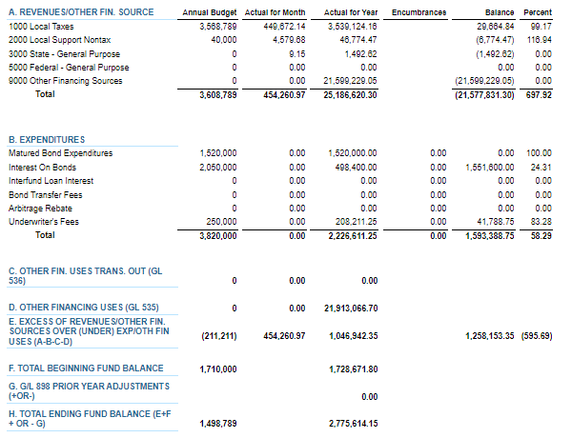
MAY 2024 BUDGET STATUS REPORT – DEBT SERVICE FUND

Slide 6
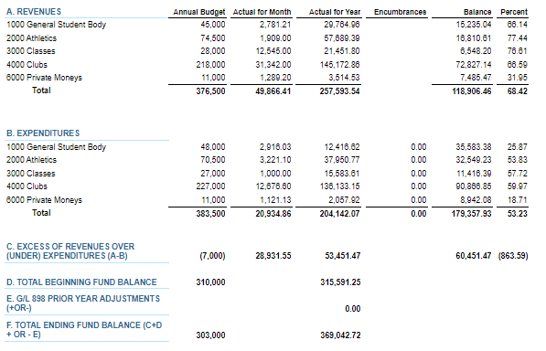
MAY 2024 BUDGET STATUS REPORT – ASB FUND

Slide 7
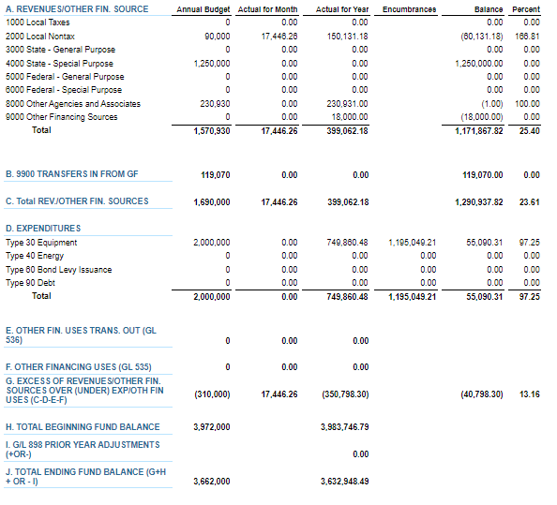
MAY 2024 BUDGET STATUS REPORT – TRANSPORTATION VEHICLE FUND

